Slide 1

PROJECT OBJECTS 10 DEAMAND WIDGETS
© 2021 Project Objects

Slide 2
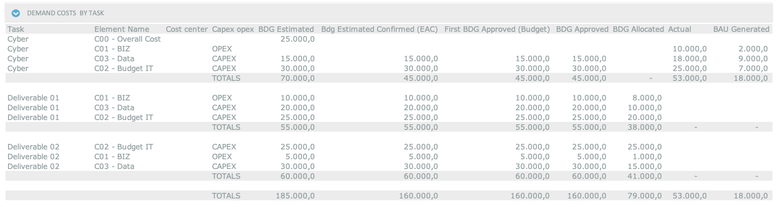
DEMAND COSTS GROUPED BY DELIVERABLE

Slide 3
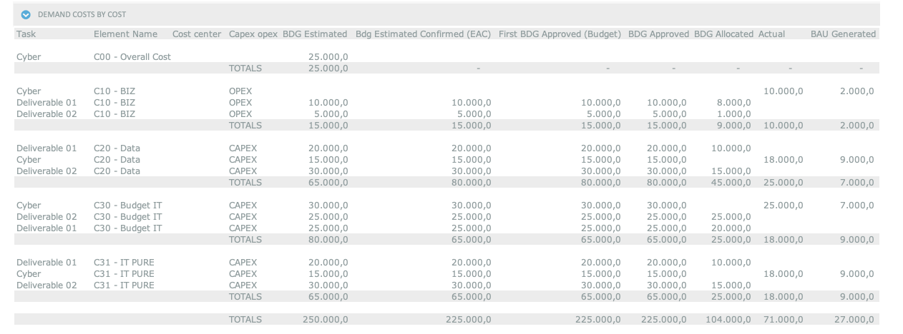
DEMAND COSTS GROUPPED BY COST ELEMENT

